Slide 1
Virtual Memory

Slide 2
Background
Virtual memory – program uses virtual memory which can be partially loaded into physical memory
Benefits:
Only part of the program needs to be in memory for execution
more concurrent programs
Logical address space can therefore be much larger than physical address space
execute programs larger than RAM size
Easy sharing of address spaces by several processes
Library or a memory segment can be shared
Allows for more efficient process creation

Slide 3
Virtual Memory That is Larger Than Physical Memory
Page 0
0
Page 1
1
2
Page 2
Page 2
3
Page 0
Page 1
4
unavail
Page 3
Page 2
Page 3
…
Page 0
move pages
…
Page 4
unavail
Page 4
Page 3
n-2
Page 1
page n-2
Page n-1
n-1
page table
Physical memory
page n-2
page n-1
all pages of program sitting on physical Disk
Virtual memory

Slide 4

A typical virtual-address space layout of a process
function parameters;
local variables;
return addresses
unused address space
will be used whenever
needed
malloc() allocates
space from here
(dynamic memory allocation)
global data (variables)

Slide 5
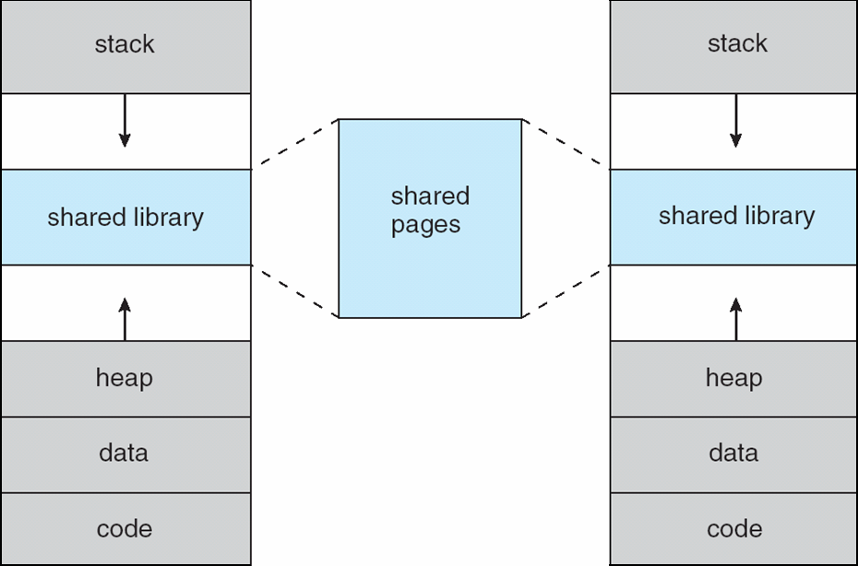
Shared Library Using Virtual Memory
Virtual memory of process A
Virtual memory of process B
only one copy of
a page needs to
be in memory

Slide 6
Implementing Virtual Memory
Virtual memory can be implemented via:
Demand paging
Bring pages into memory when they are used, i.e. allocate memory for pages when they are used
Demand segmentation
Bring segments into memory when they are used, i.e. allocate memory for segments when they are used.

Slide 7
Policies for Paging/ Segmentation
Fetch Strategies
When should a page or segment be brought into primary memory from secondary (disk) storage?
Demand Fetch
Anticipatory Fetch
Placement Strategies
where is it to be put?
Paging - trivial
Segmentation - significant problem
Replacement Strategies
Which page/segment should be replaced if there is not enough room for a required page/segment?

Slide 8
Demand Paging
Bring a page into memory only when it is needed
Less I/O needed
Less memory needed
Faster response
More users
Page is needed ⇒ reference to it
invalid reference (page is not in used portion of address space) ⇒ abort
not-in-memory ⇒ bring to memory
Pager never brings a page into memory unless page will be needed

Slide 9
Valid-Invalid Bit
With each page table entry a valid–invalid bit is associated (v ⇒ in-memory, i ⇒ not-in-memory)
Initially valid–invalid bit is set to i on all entries
Example of a page table snapshot:
During address translation, if valid–invalid bit in page table entry
is i ⇒ page fault
Frame #
valid-invalid bit
v
v
v
v
i
….
i
i
page table

Slide 10
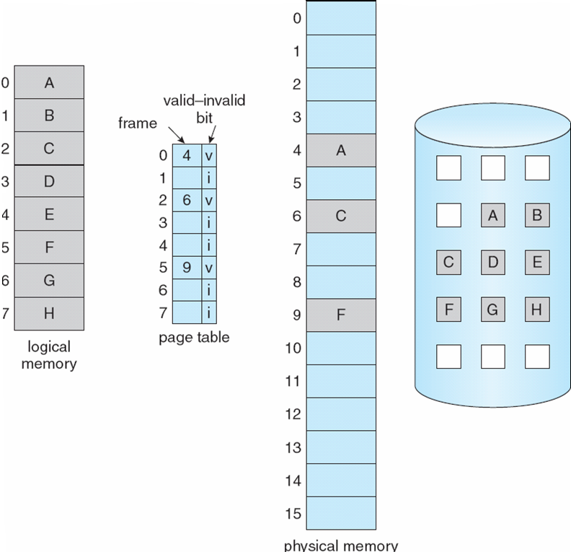
Page Table When Some Pages Are Not in Main Memory

Slide 11
Page Fault
When CPU makes a memory reference (i.e. page reference), HW consults the page table. If entry is invalid, then exception occurs and kernel gets executed.
Kernel handling such as case:
Kernel looks at another table to decide:
Invalid reference (page is in unused portion of address space) → Abort
Just not in memory (page is in used portion, but not in RAM) → Page Fault
Get empty frame (we may need to remove a page; if removed page is modified, we need disk I/O to swap it out)
Swap page into frame (we need disk I/O)
Reset tables (install mapping into page table)
Set validation bit = v
Restart the instruction that caused the page fault

Slide 12
Page Fault (Cont.)
If page fault occurs when trying to fetch an instruction, fetch the instruction again after bringing the page in.
If page fault occurs while we are executing an instruction: Restart the instruction after bringing the page in.

Slide 13

Steps in Handling a Page Fault
swap
space

Slide 14
What happens if there is no free frame?
Page replacement – find some page in memory, but not really in use, swap it out
Algorithm ? Which page should be remove?
performance – want an algorithm which will result in minimum number of page faults
With page replacement, same page may be brought into memory several times

Slide 15
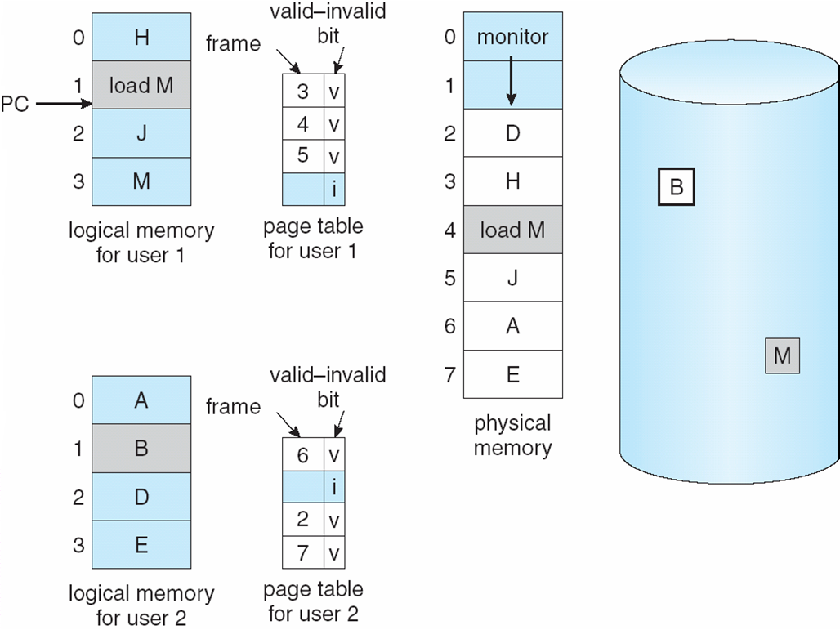
Need For Page Replacement
While executing “load M”
we will have a page fault and we need
page replacement.

Slide 16
Basic Page Replacement
Steps performed by OS while replacing a page upon a page fault:
Find the location of the desired page on disk
Find a free frame: - If there is a free frame, use it - If there is no free frame, use a page replacement algorithm to select a victim frame; if the victim page is modified, write it back to disk.
Bring the desired page into the (new) free frame; update the page and frame tables
Restart the process

Slide 17
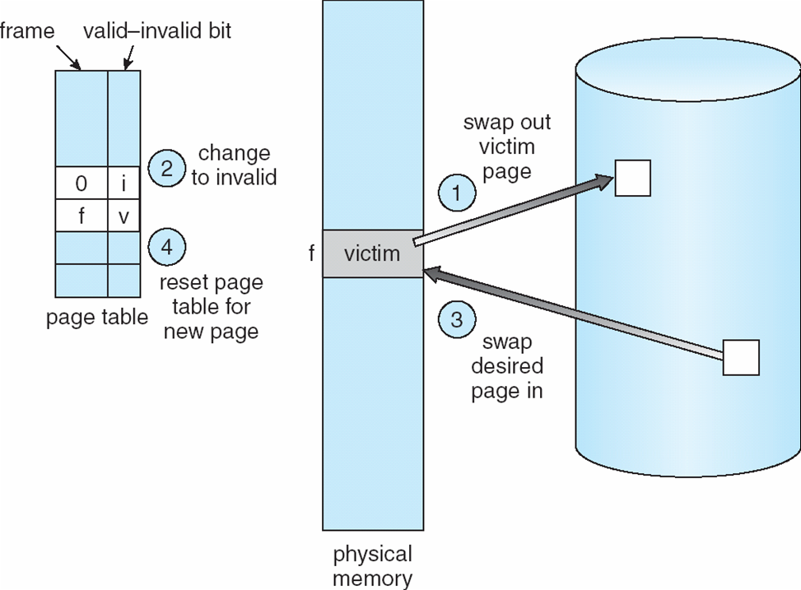
Page Replacement

Slide 18
Page Replacement Algorithms
Want lowest page-fault rate
Evaluate algorithm by running it on a particular string of memory references (reference string) and computing the number of page faults on that string
In all our examples, the reference string is
1, 2, 3, 4, 1, 2, 5, 1, 2, 3, 4, 5

Slide 19
Driving reference string
Assume process makes the following memory references (in decimal) in a system with 100 bytes per page:
0100 0432 0101 0612 0102 0103 0104 0101 0611 0102 0103 0104 0101 0610 0102 0103 0104 0609 0102 0105
Example: Bytes (addresses) 0…99 will be in page 0
Pages referenced with each memory reference
1, 4, 1, 6, 1, 1, 1, 1, 6, 1, 1, 1, 1, 6, 1, 1, 6, 1, 1
Corresponding page reference string
1, 4, 1, 6, 1, 6, 1, 6, 1, 6, 1

Slide 20
First-In-First-Out (FIFO) Algorithm
Reference string: 1, 2, 3, 4, 1, 2, 5, 1, 2, 3, 4, 5
3 frames (3 pages can be in memory at a time per process)
4 frames
Belady’s Anomaly: more frames ⇒ more page faults
1
1
4
5
2
2
1
3
9 page faults
3
3
2
4
1
1
5
4
2
2
1
5
10 page faults
3
3
2
4
4
3

Slide 21
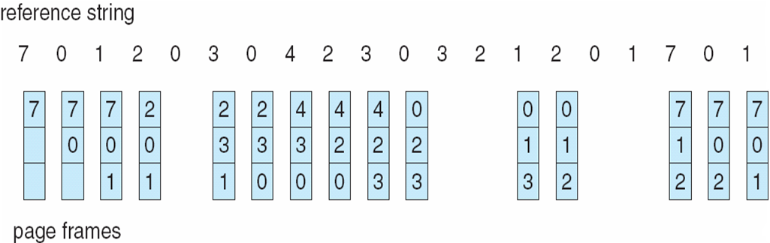
FIFO Page Replacement

Slide 22
Optimal Algorithm
Replace page that will not be used for longest period of time
4 frames example
1, 2, 3, 4, 1, 2, 5, 1, 2, 3, 4, 5
How do you know this?
Used for measuring how well your algorithm performs
1
4
2
6 page faults
3
4
5

Slide 23
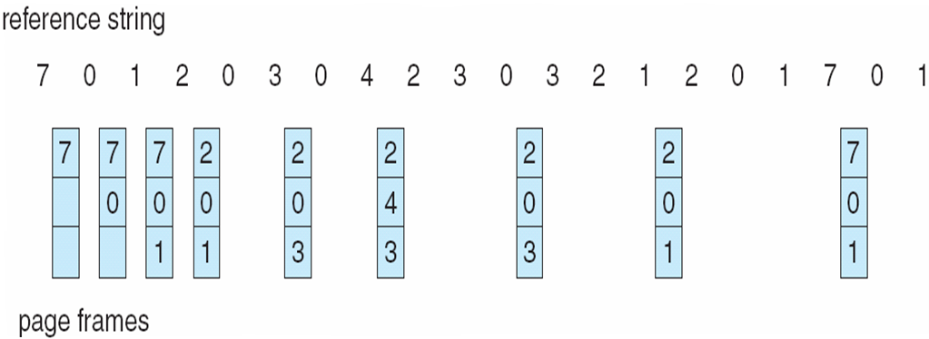
Optimal Page Replacement

Slide 24
Least Recently Used (LRU) Algorithm
Reference string: 1, 2, 3, 4, 1, 2, 5, 1, 2, 3, 4, 5
1
1
1
1
5
2
2
2
2
2
3
5
5
4
4
4
4
3
3
3
8 page faults

Slide 25
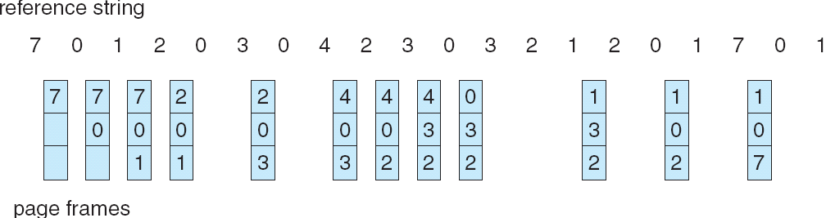
LRU Page Replacement

Slide 26
LRU Algorithm Implementation
Counter implementation
Every page entry has a counter field; every time page is referenced through this entry, copy the clock into the counter field
When a page needs to be replaced, look at the counters to determine which one to replace
The one with the smallest counter value will be replaced

Slide 27
LRU Algorithm Implementation
Stack implementation – keep a stack of page numbers
Page referenced:
move it to the top
No search for replacement (replacement fast)

Slide 28
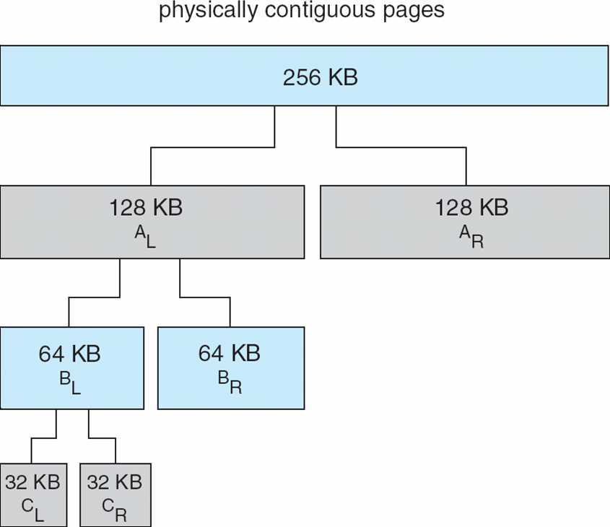
Buddy System Allocator

Slide 29
Example
Object A needs memory 45 KB in size
Object B needs memory 70 KB in size
Object C needs memory 50 KB in size
Object D needs memory 90 KB in size
Object C removed
Object A removed
Object B removed
Object D removed

Slide 30
Example
512 KB of Memory (physically contiguous area)
A
C
B
D
Alloc A 45 KB
Alloc B 70 KB
Alloc C 50 KB
Alloc D 90 KB
Free C
Free A
Free B
Free D
512
256
256
128
128(B)
128
128
128(D)
128
64(A)
64
64(C)
64

